Slide 1
Application Layer Functionality and Protocols
Dr. Muazzam A. Khan

Slide 2
Objectives
Define the application layer as the source and destination of data for communication across networks.
Explain the role of protocols in supporting communication between server and client processes.
Describe the features, operation, and use of well-known application layer services
(HTTP, DNS, SMTP, FTP).

Slide 3
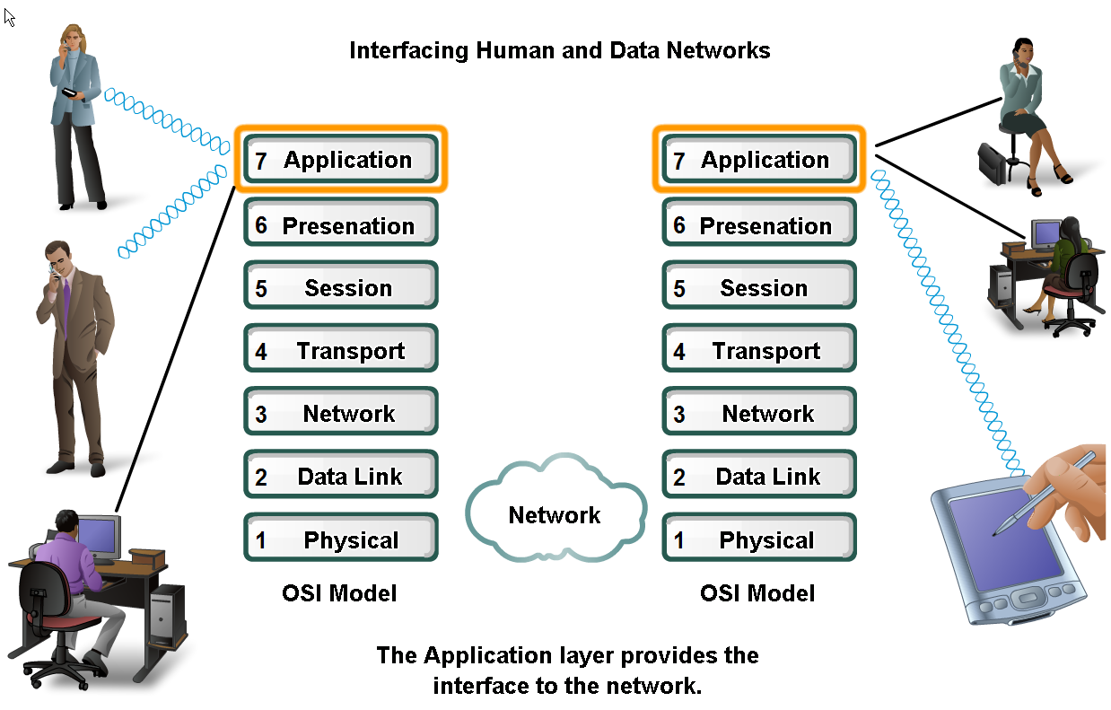
Applications –
The Interface Btw Human and Data Networks
People use application that enables them to send and receive data.
As a network professionals it is important to know
How they work
How they format,
How to send and interpret data.
This can be achieved easier by using the OSI layered model

Slide 4
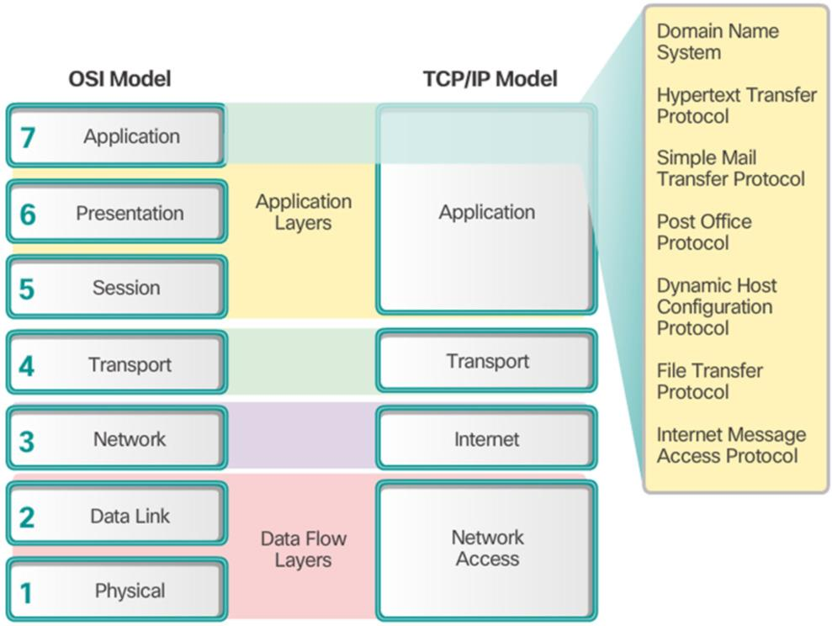
OSI and TCP/IP Model
OSI model divides the network to 7 layers
Each of which has unique functionality with specific services and protocols
The data is passed from one layer to the next proceeding down the hierarchy to the Physical layer.
The data that passed over the channel to the destination host proceeding the hierarchy ending at the Application layer.

Slide 5
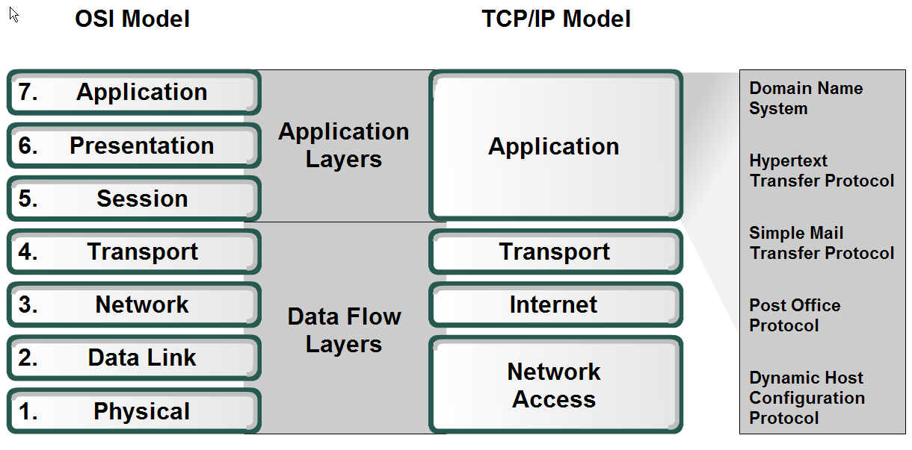
Application Layer
The application layer acts as interface between the applications and the underlying network.
Application layer protocols help exchange data between programs running on the source and destination hosts.
The TCP/IP application layer performs the functions of the upper three layers of the OSI model.
Common application layer protocols include: HTTP, FTP, TFTP, DNS.

Slide 6
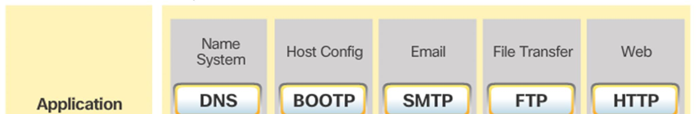
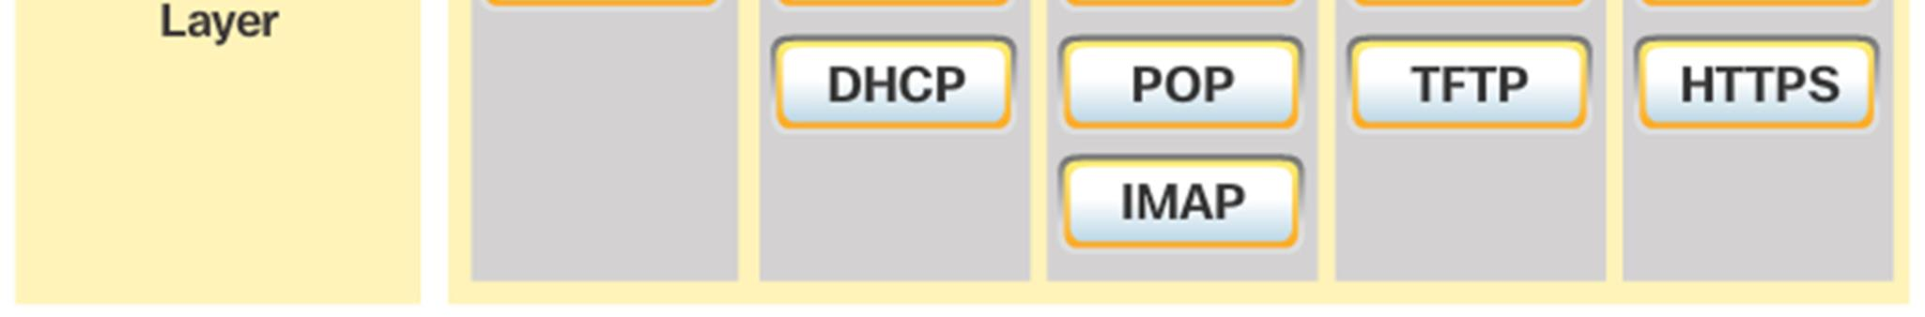
Application Layer
Application protocols specify the format and control information necessary for common Internet functions.
Application layer protocols implemented on the source and destination host must be compatible to allow communication.

Slide 7
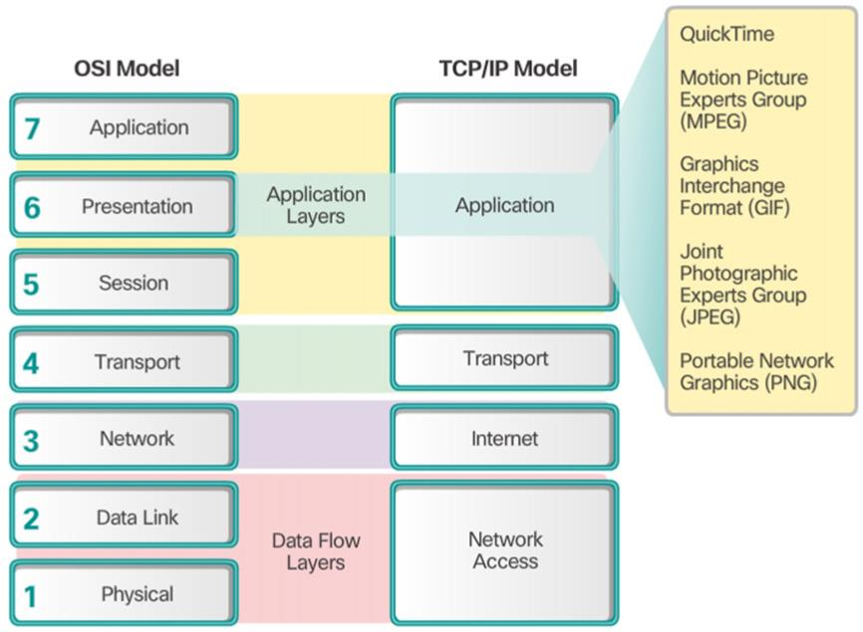
Presentation Layer
The presentation layer has three primary functions:
  Format data
  Compress data
  Encrypt data
Common standards for video include QuickTime and Motion Picture Experts Group (MPEG).
Common graphic image formats are:
Graphics Interchange Format (GIF)
Joint Photographic Experts Group (JPEG)
Portable Network Graphics (PNG) format

Slide 8
Session Layer
The session layer creates and maintains dialogs between source and destination applications.
The session layer handles
The exchange of information to initiate dialogs,
Keep them active,
Restart sessions that are disrupted or idle for a long period of time.

Slide 9
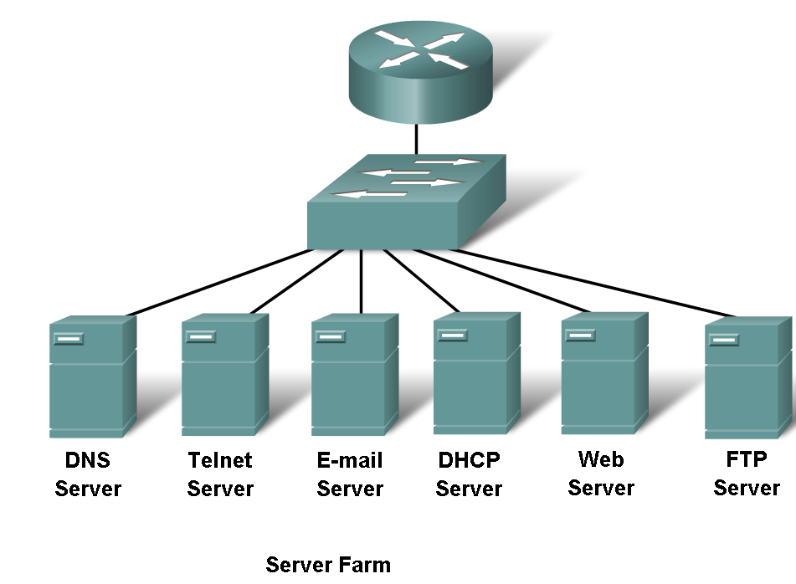
Application Layer Protocols
Widely used Application layer protocols that are used
  Domain Name Service Protocol (DNS) is used to resolve Internet names to IP addresses
  Hypertext Transfer Protocol (HTTP) is used to transfer files that make up the Web pages of the World Wide Web
  Simple Mail Transfe Protocol (SMTP) is used for the transfer of mail messages and attachments
  Telnet, is used to provide remote access to servers and networking devices
  File Transfer Protocol (FTP) is used for interactive file transfer between systems

Slide 10
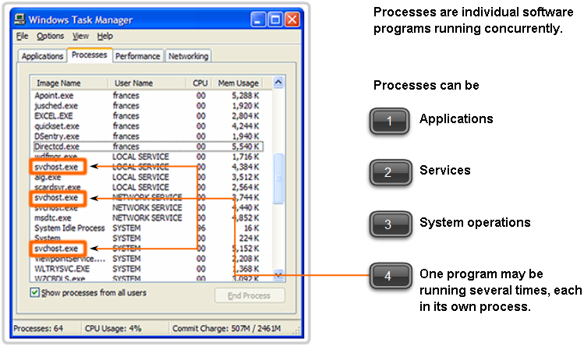
Application Layer Software
There are two forms of software processes that provide access to the network:
Applications and Services
Network-Aware Application: they implement the application layer protocols and are able to communicate directly with the lower layers of the protocol stack e.g. E-mail clients and web browsers
Application Layer Services: Other programs may need the assistance of Application layer services to use network resources, like file transfer or network print spooling. These services prepare the data for transfer

Slide 11
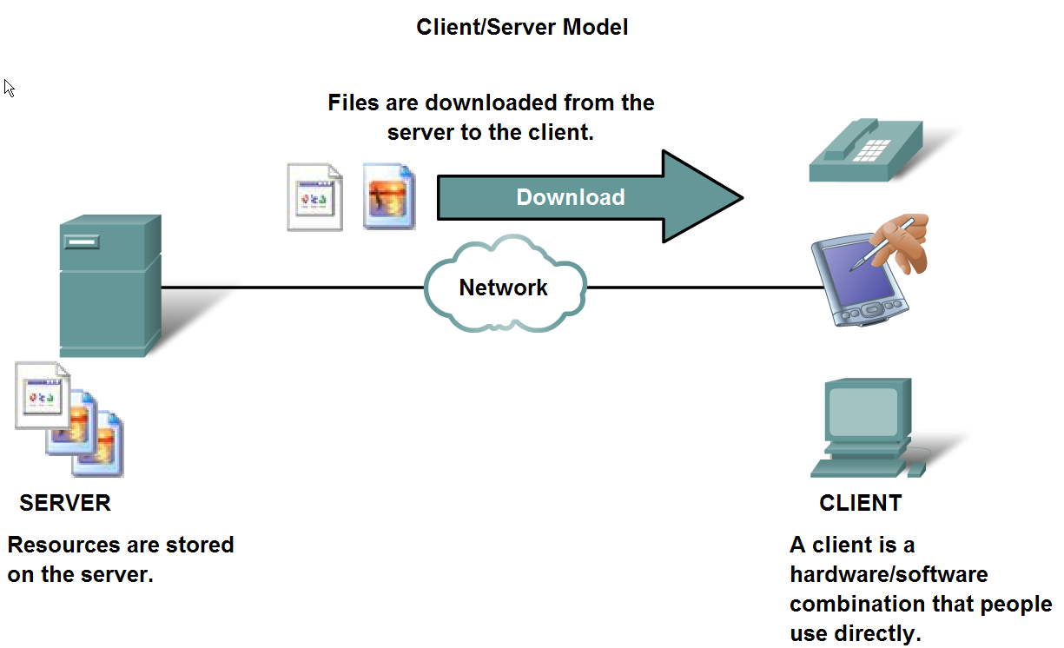
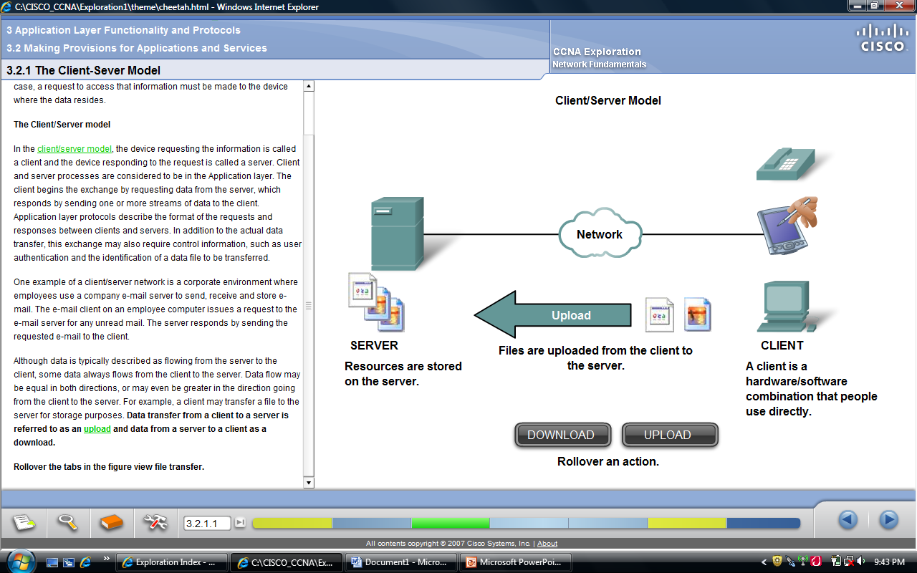
The Client/Server Model
The device requesting the information is called a client
The device responding to the request is called a server
Client and server processes are considered to be in the Application layer
Application layer protocols describe the format of the requests and responses between clients and servers

Slide 12
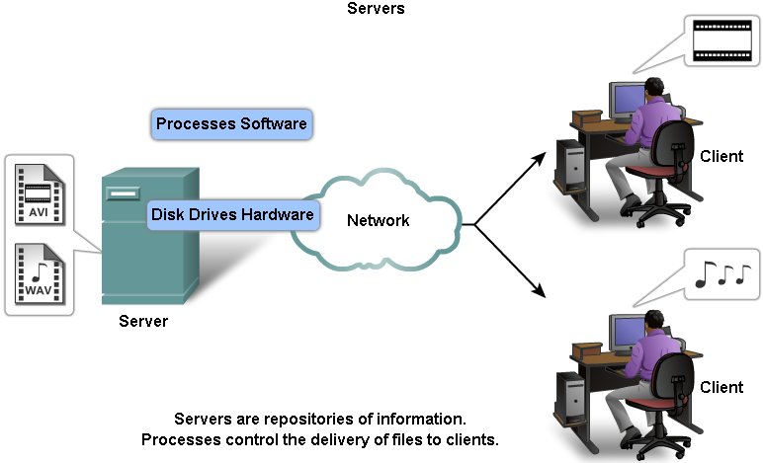
Servers
A server is usually a computer that contains information to be shared with many client systems (web pages, documents, databases, pictures, video, audio, etc)
Servers might require client authentication
In a client/server network, the server runs a service, or process, sometimes called a server daemon

Slide 13
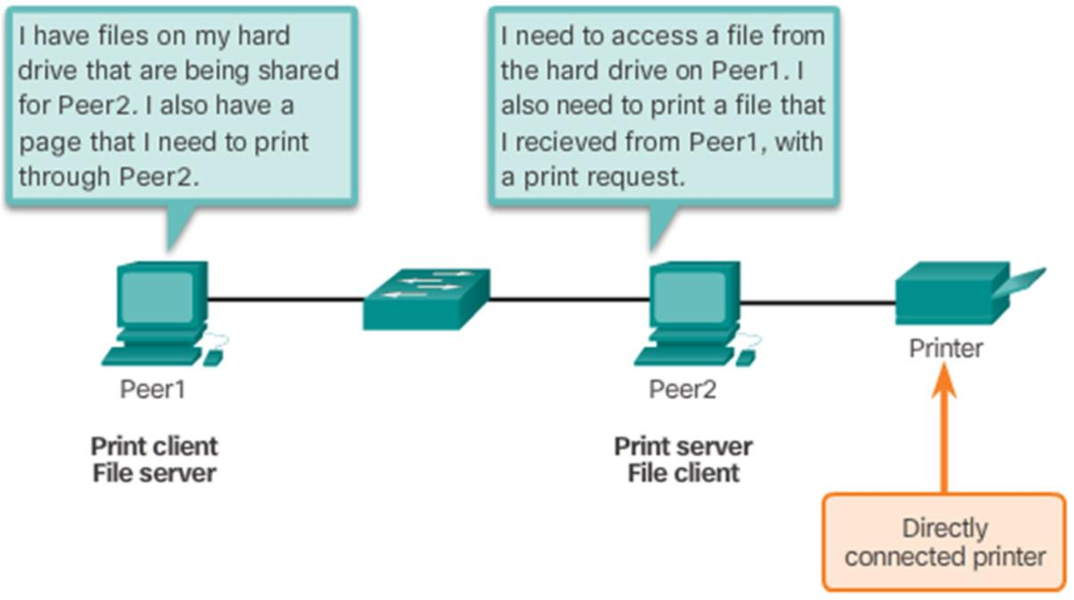
Peer to Peer Network
• In (P2P) Networking the data is accessed without the use of a dedicated server.
• Two or more computers can be connected to a P2P network to share
resources.
• Every connected end device (a peer) can function as both a server and
a client.
• The roles of client and
server are set on request basis.
Cisco Public
11

Slide 14
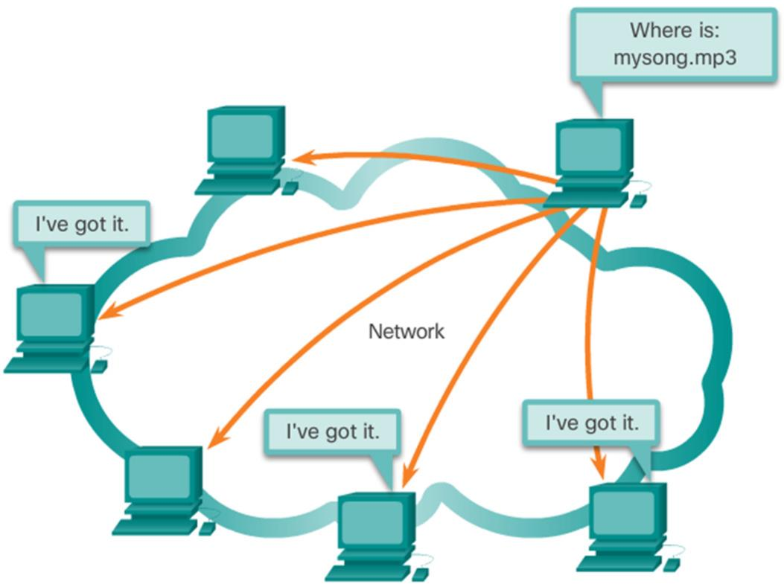
Common Peer to Peer Application
Common P2P networks include: eDonkey, G2, BitTorrent, Bitcoin,
Many P2P Applications allow users to share pieces of many files with each Other
A small torrent file contains information about the location of other users and tracker computers.
Trackers are Computer Keeping track of the files hosted by users.
This technology is called Bit Torrent
There are many BitTorrent clients, including
BitTorrent, uTorrent, Frostwire, and qBittorrent.
13

Slide 15
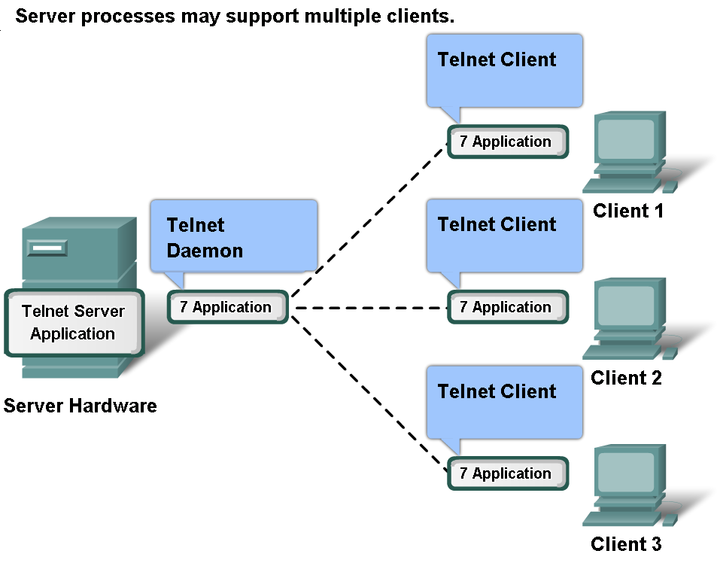
Application Layer Services and Protocols
A server might receive multiple client requests at the same time.
The Application layer processes and services rely on support from lower layer functions to successfully manage the multiple conversations

Slide 16
Identifiers of Application Layer Services
The Transport layer uses an addressing scheme called a port number
Port numbers identify applications and Application layer services that are the source and destination of data
Some common port numbers are
  Domain Name System (DNS) - TCP/UDP Port 53
  Hypertext Transfer Protocol (HTTP) - TCP Port 80
  Simple Mail Transfer Protocol (SMTP) - TCP Port 25
  Post Office Protocol (POP) - UDP Port 110
  Telnet - TCP Port 23
  Dynamic Host Configuration Protocol - UDP Port 67
  File Transfer Protocol (FTP) - TCP Ports 20 and 21

Slide 17
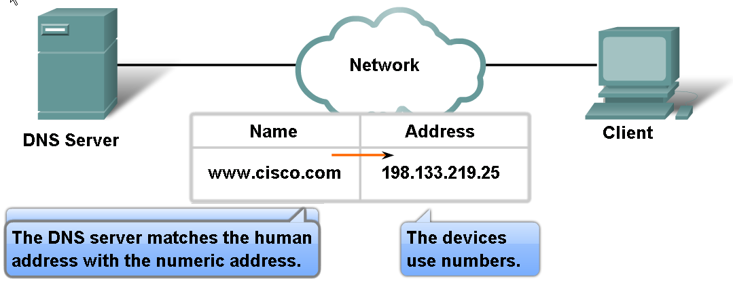
DNS Services and Protocol
IP addresses are crucial for network communication, they are not easy to memorize.
So domain names are created to make server addresses more user- friendly.
Domain names such as http://www.cisco.com are user-friendly addresses associated with the IP address of a specific server.
However, computers still need the actual numeric address before they can communicate.

Slide 18
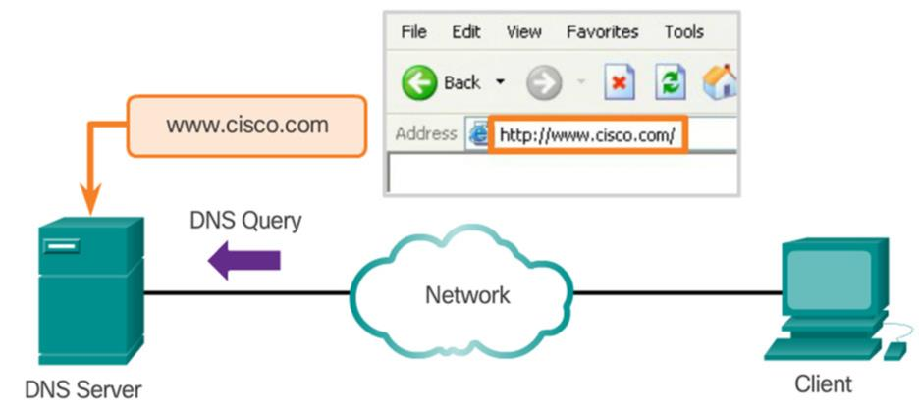
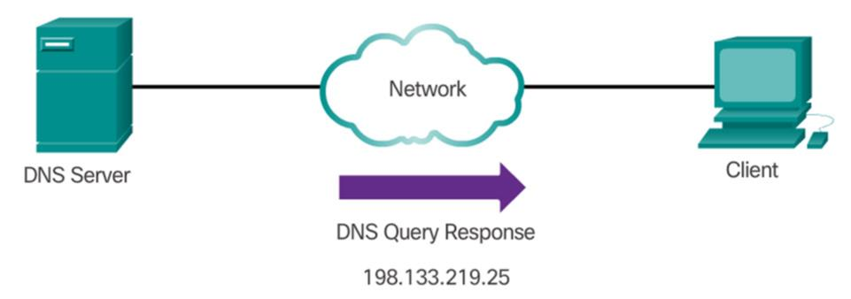
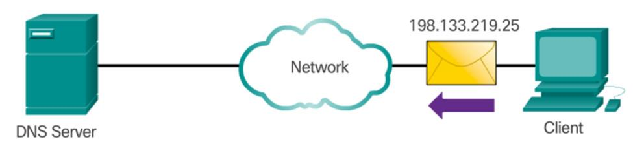
DNS Services and Protocol
The DNS protocol allows for the dynamic translation of a domain name into the correct IP address.
When a client makes a query,
The server's first looks at its own records to see if it can resolve the name.
If it is unable to resolve the name using its stored records, it contacts other servers in order to resolve the name.
ipconfig /displaydns displays all of the cached DNS entries on Windows.

Slide 19
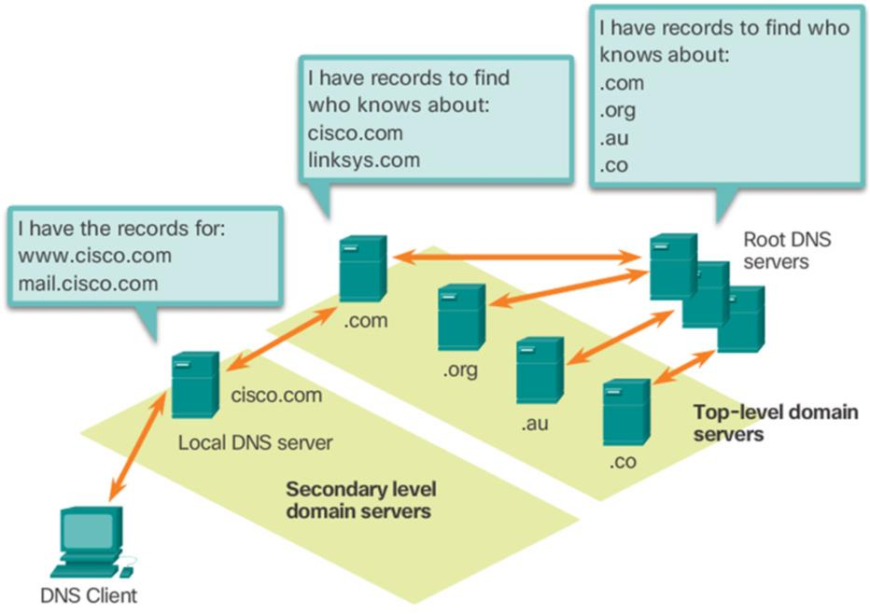
DNS Hierarchy
DNS has hierarchical system, with the root at the top and branches below.
The naming structure is broken down into small, manageable zones.
Top-level domains represent either the type of domain or the country of origin. Examples of top-level domains are:
.com - a business or industry
.org - a non-profit organization
.au – Australia
.de - Germany
.pk - Pakistan

Slide 20
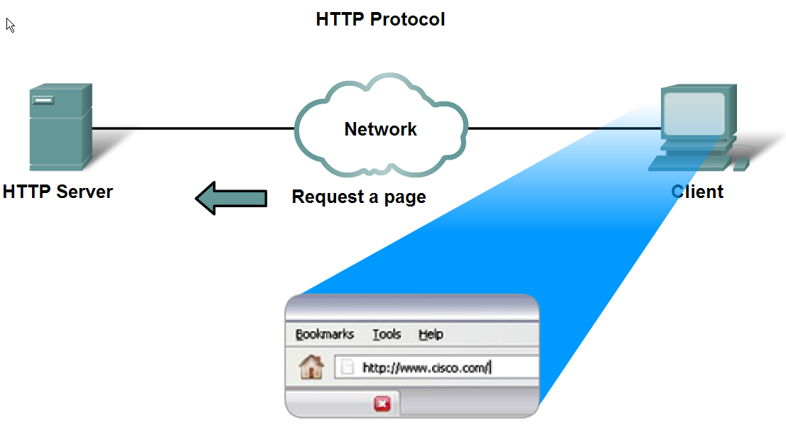
WWW Service and HTTP
When a web address (or URL) is typed into a web browser,
Name portion of the URL is translated to the associated IP address Using DNS server .
Web browser establishes a connection to the web server using the HTTP protocol
To access the content, web clients request the desired resources from server.
HTTP Protocol Step 1
The URL http://www.cisco.com/index.html is an example
A specific resource - a web page named index.html on a server identified as cisco.com

Slide 21
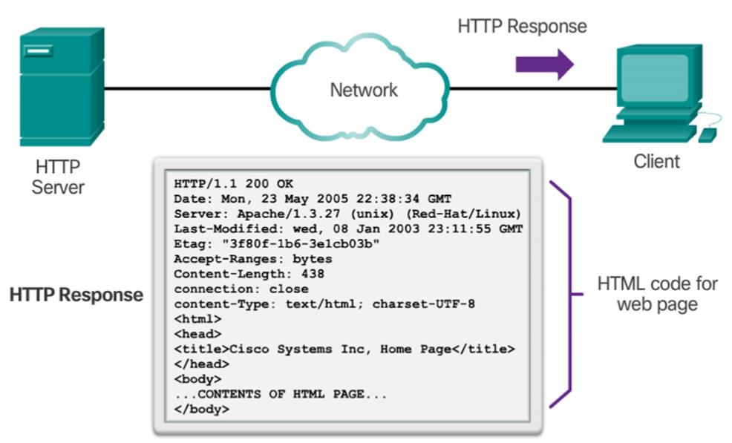
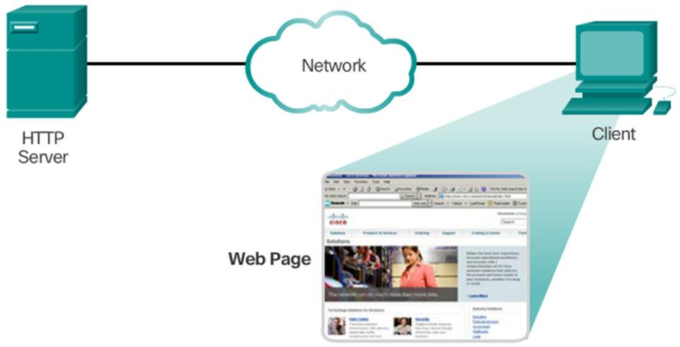
HTTP
HTTP Protocol Step 2
The browser sends a GET request to the server’s IP address and asks for the index.html file.
The server sends the requested file to the client.
The index.html was specified in the URL and contains the HTML code for this web page.
The browser processes the HTML code and formats the page for the browser window based on the code in the file.
HTTP Protocol Step 3

Slide 22
Common Message Types
The three common message types are GET, POST, and PUT
  GET is a client request for data.
  A web browser sends the GET message to request pages from a web server
  POST and PUT are used to send messages that upload data to the web server
HTTP is not a secure protocol. For secure posting and accessing of web pages HTTPS protocol is used.

Slide 23
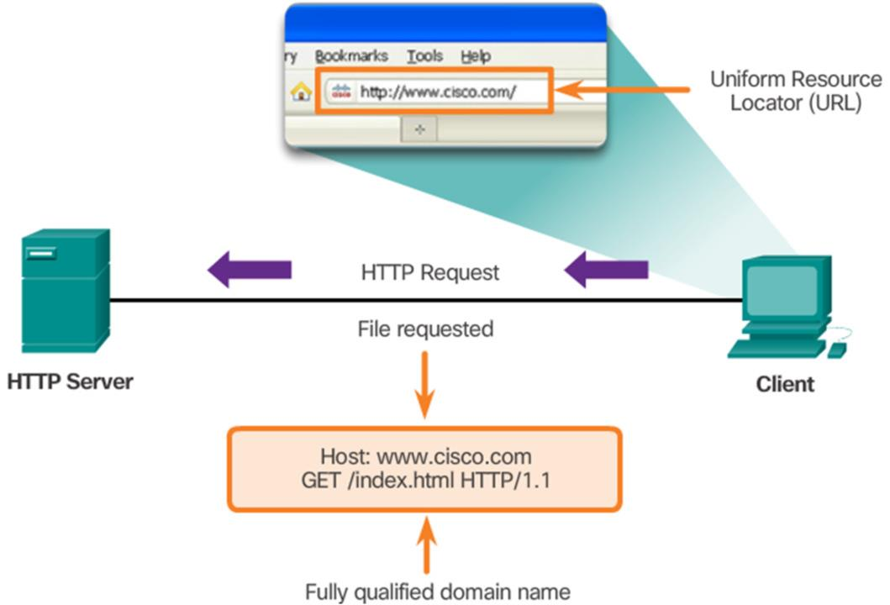
HTTP

Slide 24
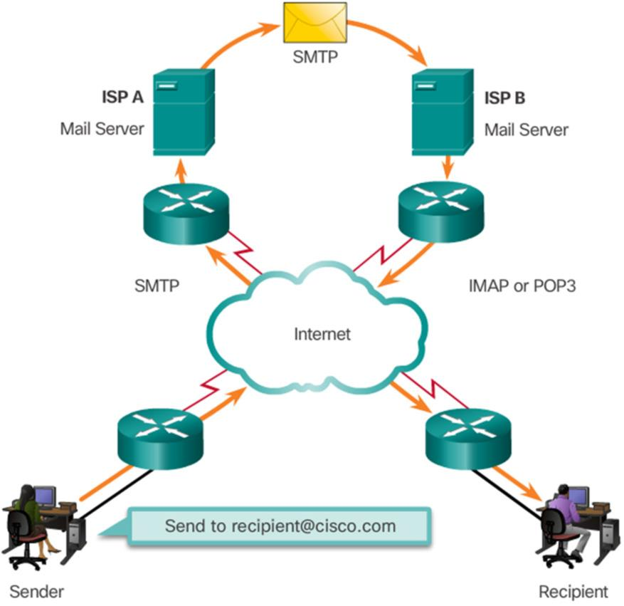
Email Services
Email is a store-and-forward method of sending, storing, and retrieving electronic msgs.
Email messages are stored in databases on mail servers.
Email clients communicate with mail servers
to send and receive email.
Mail servers communicate with other mail servers to transport messages from one domain to another.
Email clients do not communicate directly when sending email.
Email relies on three separate protocols
for operation: SMTP (sending),POP (retrieving), IMAP (retrieving).

Slide 25
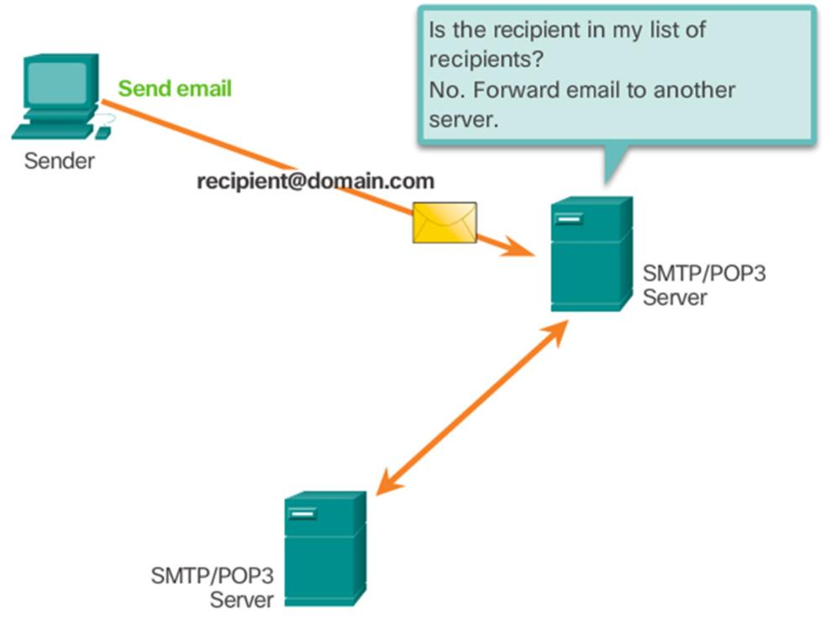
SMTP Operation
SMTP message formats [header and body]
Body contain any amount of text.
Header have recipient & sender Email.
SMTP client sends an email by
connecting to a SMTP server on port 25.
Server receives the message and stores
it in a local mailbox or relays it to another
mail server.
Users use email clients to retrieve messages stored on the server.
IMAP and POP are two protocols commonly used by email clients to retrieve messages.

Slide 26
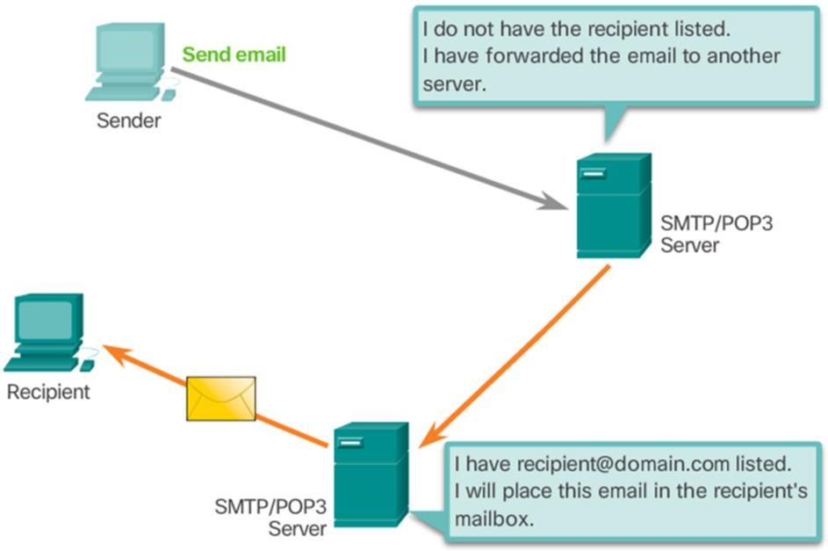
POP Operation
Messages are downloaded from server to client.
The server listens on port 110 for client requests.
Email clients direct their POP requests to mail servers on port 110.
POP allows for email messages to be
downloaded to the client’s device.
There is no centralized location where
email messages are kept.

Slide 27
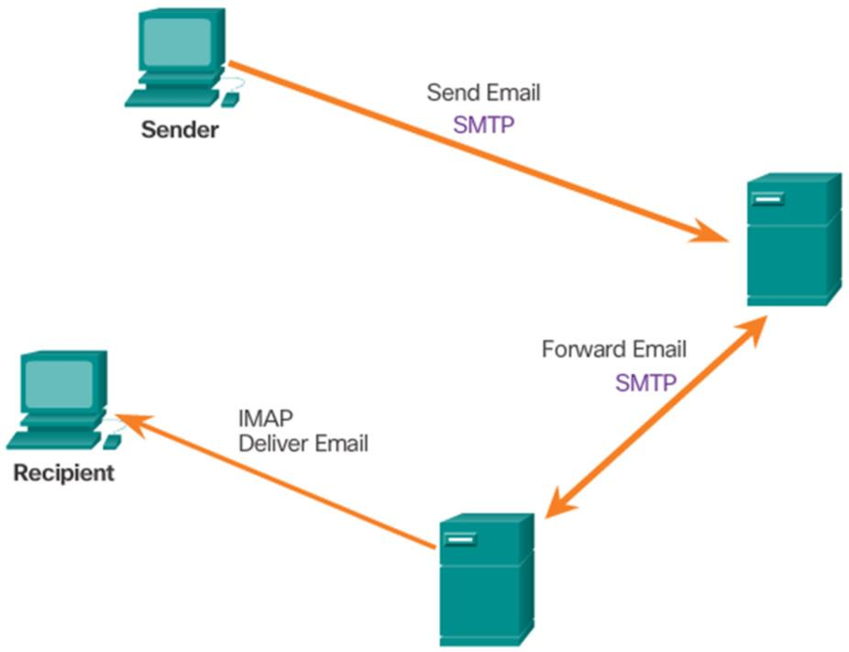
IMAP (Internet Message Access Protocol) Opertion
IMAP also used to retrieve email messages.
Allows for messages to be displayed to
the user rather than downloaded.
Original messages reside on the server until manually deleted by the user.
Users view copies of the messages in their email client software.
Users can create a folder hierarchy on the server to organize and store mail.
When a user decides to delete a message, the server synchronizes that action and deletes the message from the server.

Slide 28
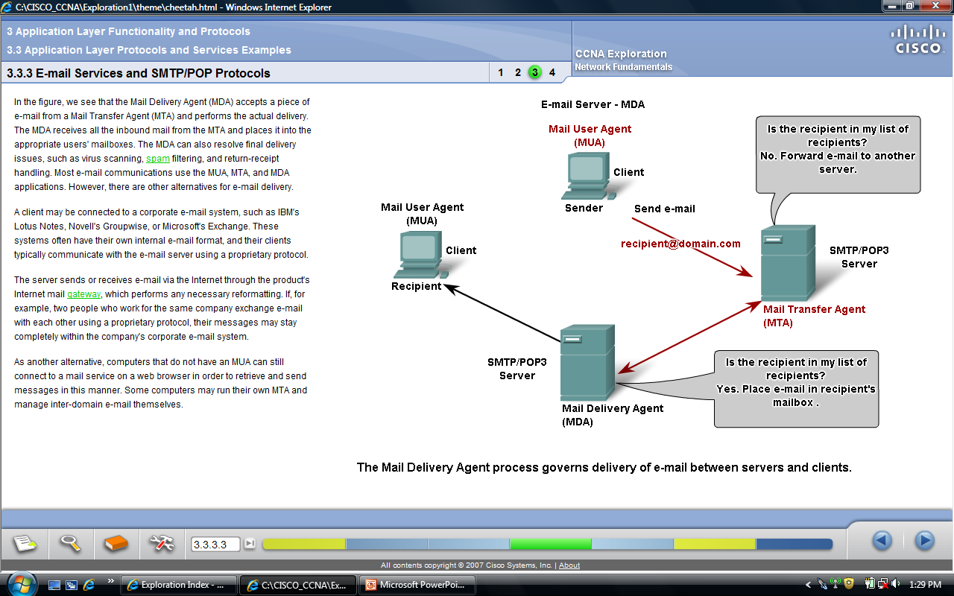
Email Services and SMTP/POP Protocols
When people compose e-mail msgs, they typically use an application called a Mail User Agent (MUA), which enables sending messages and getting messages into client’s mail box
Mail Transfer Agent (MTA) process is used to forward e-mail
Mail Delivery Agent (MDA) is used If the mail is addressed to a user whose mailbox is on the local server
The MDA can also resolve final delivery issues, such as virus scanning, spam filtering, and return-receipt handling

Slide 29
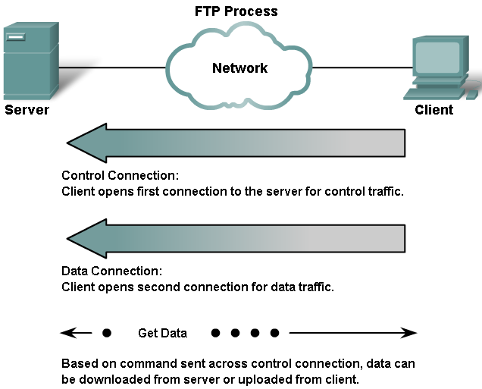
File Transfer Protocol (FTP)
FTP is an Application layer protocol
FTP client runs on a computer that is used to push and pull files.
Client initiates and establishes the first connection for control traffic on TCP port 21.
Client then establishes the second connection to the server for the actual data transfer on TCP port 20.
The client can download (pull) a file from the server or, upload (push) a file to the server

Slide 30
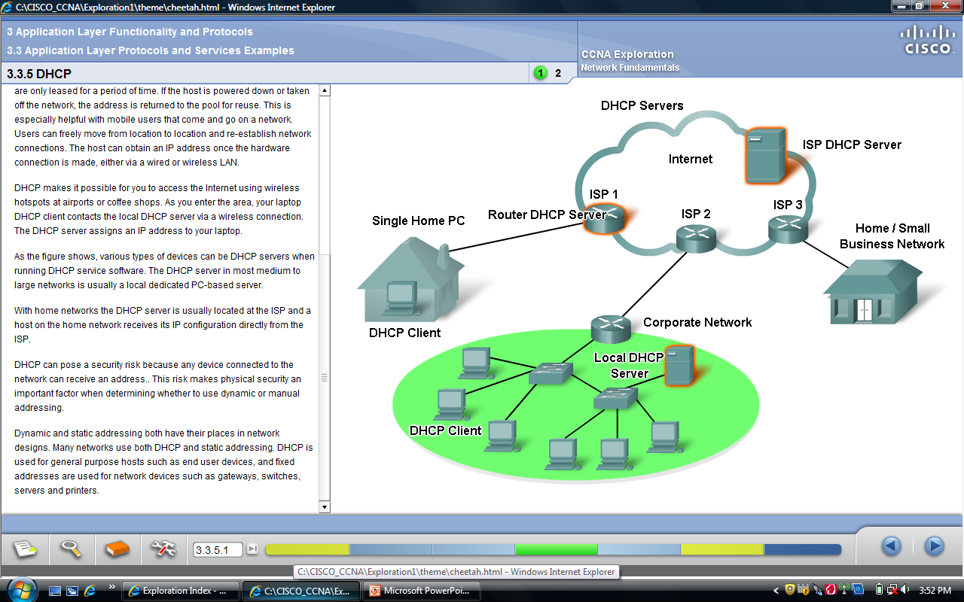
Dynamic Host Configuration Protocol (DHCP)
Computers need network addresses to communicate over a network.
Additional crucial information includes gateway address, subnet mask, and DNS
Manual config of end devices is not scalable/affordable.
DHCP allows for automated distribution of network information.
Addresses are returned to the pool for reuse when no longer in use.
DHCP supports IPv4 and DHCPv6 supports IPv6.

Slide 31
Dynamic Host Configuration Protocol (DHCP)
DHCP server chooses an address from a configured range of addresses called a pool and assigns ("leases") it to the host for a set period
DHCP makes it possible for you to access the Internet using wireless hotspots at airports or coffee shops
Many networks use both DHCP and static addressing.
DHCP is used for general purpose hosts such as end user devices, and fixed addresses are used for network devices such as gateways, routers, servers and printers.

Slide 32
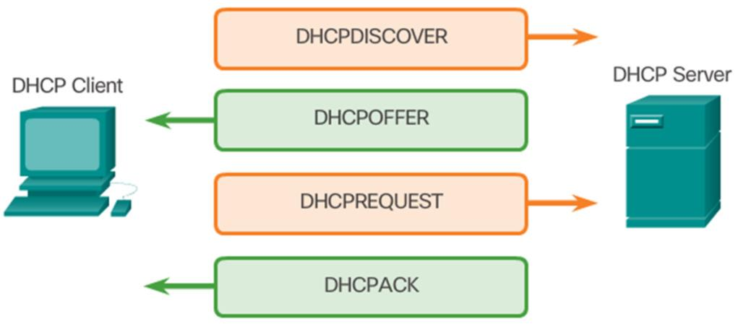
Dynamic Host Configuration Protocol (DHCP)
A DHCP client goes through the following basic steps to request an IP:
1. The client broadcasts a DHCPDISCOVER.
2. A DHCP server replies with a DHCPOFFER message
3. The client sends a DHCPREQUEST message to the server it wants to use (in case of multiple offers).
A client may also choose to request
an address that it had previously been
allocated by the server.
The server returns a DHCPACK
message to confirm the lease has
been finalized.

Slide 33
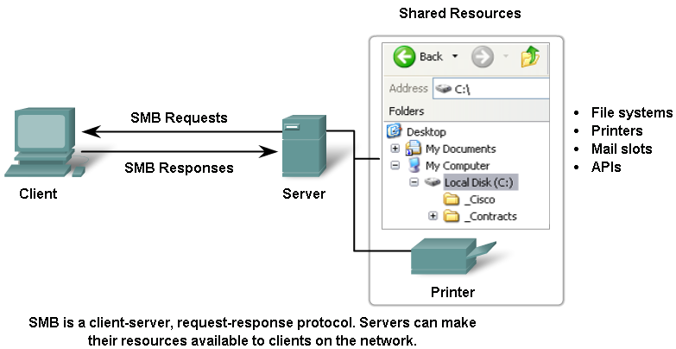
Server Message Block (SMB) Protocol
SMB is a client/server file sharing protocol
Developed by IBM in the late 1980s to describe the structure of shared network resources.
It is a request-response protocol
Unlike the file sharing supported by FTP, clients establish a long term connection to servers.
Once the connection is established, the user of the client can access the resources on the server as if the resource is local to the client host
SMB file-sharing and print services have become the main stay of Microsoft networking.

Slide 34
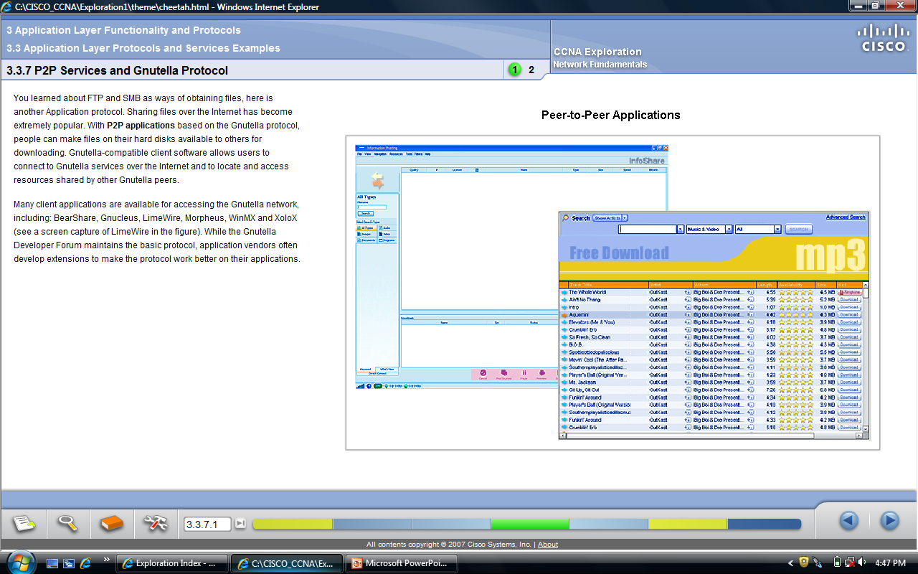
Gnutella Protocol and P2P Services
Sharing files over the Internet has become extremely popular
With P2P applications based on the Gnutella protocol, people can make files on their hard disks available to others for downloading
Gnutella-compatible client software allows users to connect to Gnutella services over the Internet and to locate and access resources shared by other Gnutella peers
Many client applications are available for accessing the Gnutella network, including: BearShare, Gnucleus, LimeWire, Morpheus, WinMX and XoloX

Slide 35
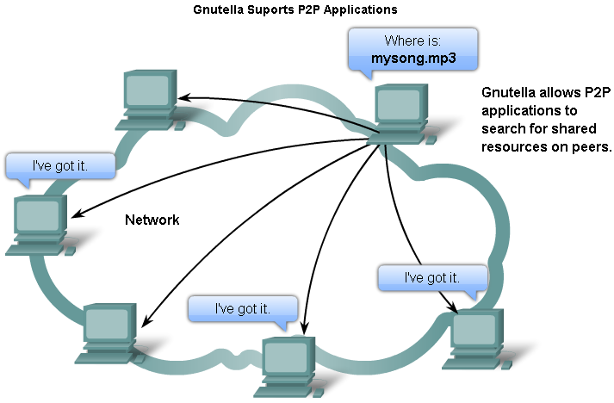
Gnutella Protocol & P2P Services
Many P2P applications do not use a central database to record all the files available on the peers
The devices on the network each tell the other what files are available when queried and use the Gnutella protocol.
When a user is connected to a Gnutella service, the client applications will search for other Gnutella nodes to connect to
File transfers usually rely on HTTP services
Gnutella protocol defines five different packet types:
  ping - for device discovery
  pong - as a reply to a ping
  query - for file location
  query hit - as a reply to a query
  push - as a download request

Slide 36
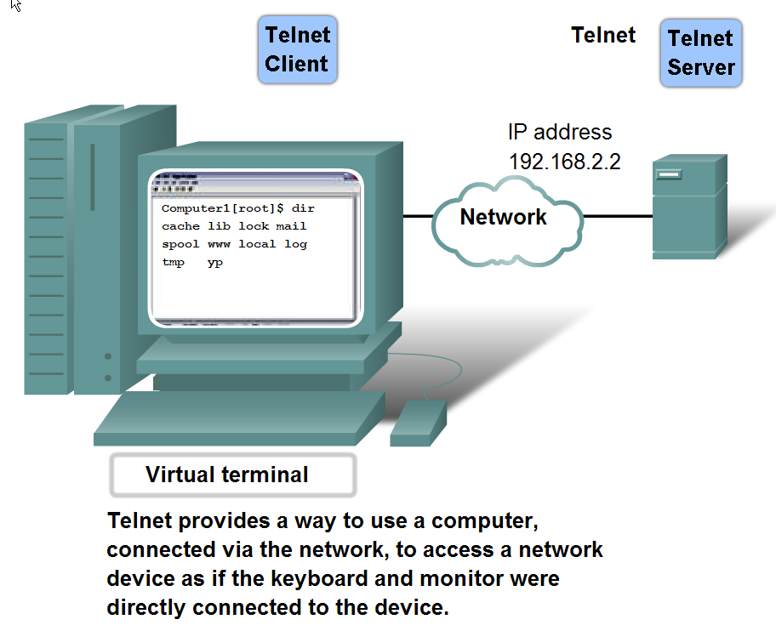
Telnet
Telnet is a protocol and a service that provides text-based terminal emulation to connect to remote devices over the network
A connection using Telnet is called a Virtual Terminal (VTY) session, or connection
A virtual terminal connection is established from an end device using a Telnet client application
Telnet does not support the transport of encrypted data. All data exchanged during a Telnet sessions is transported as plain text across the network
If security is a concern then the Secured Shell (SSH) should be used

Slide 37
Chapter Objectives:
• Explain the operation of the application layer in providing support to end-user applications.
• Explain how well-known TCP/IP application layer protocols and services operate.

